Slide 1
MGMR Progress report
Group meeting 1/2/12

Slide 2
Multireads
Gene multireads due to paralogs, shared domains
Transcript multireads due to alternative splicing
Notes:
Problem we want to solve
-estimate expression in RNA-Seq, dealing with multireads from genes and isoforms
-naïve methods are to count & discard reads, assign by weight of uniquely mapped reads

Slide 3
RNA-Seq Generative Model
Notation:
G = (G₁, G₂, . . . , G_{n})
P = (P₁, P₂, . . . , P_{n});
ΣP_{i} = 1
R = (r₁, r₂, . . . , r_{m})
Model for RNA-Seq:
Choose Gi from distribution P
Generate short reads: copy (with errors) a random substring of G
Notes:
Would like to probabilistically model sequencing process in order to estimate expression levels

Slide 4
RNA-Seq Likelihood
R – observed reads
G – defined regions
P - relative expression levels
p – read/gene alignment probabilities
Notes:
What to explain:
Likelihood is probability of data given parameters
Want to estimate MLE of relative expression levels given reads and regions
Product over all reads. For each read, sum probabilities over all genes
This expression does not take into account length but sometimes appears as P/l
-instead of summing over all possible positions per gene, you take the maximal position, which is extracted from the alignment
Say this is optimized by EM

Slide 5
Our Model
Population α

Slide 6
We wish to optimize

Slide 7
Notes:
-1 problematic because can’t allow negative Ps,
alphas grow very quickly, need to avoid letting them dominate P terms → all samples then have same expression for those genes

Slide 8
sim.
SEQEM-A
Real
RNA-Seq Samples
MGMR(SEQEM)
SEQEM
sim.
SEQEM-B

Slide 9
Error measures used
P is the estimated distribution generated by the tested algorithm and Q is the true distribution
Notes:
Error rate most intuitive but not robust – differences in small values easily lead to high error rate

Slide 10
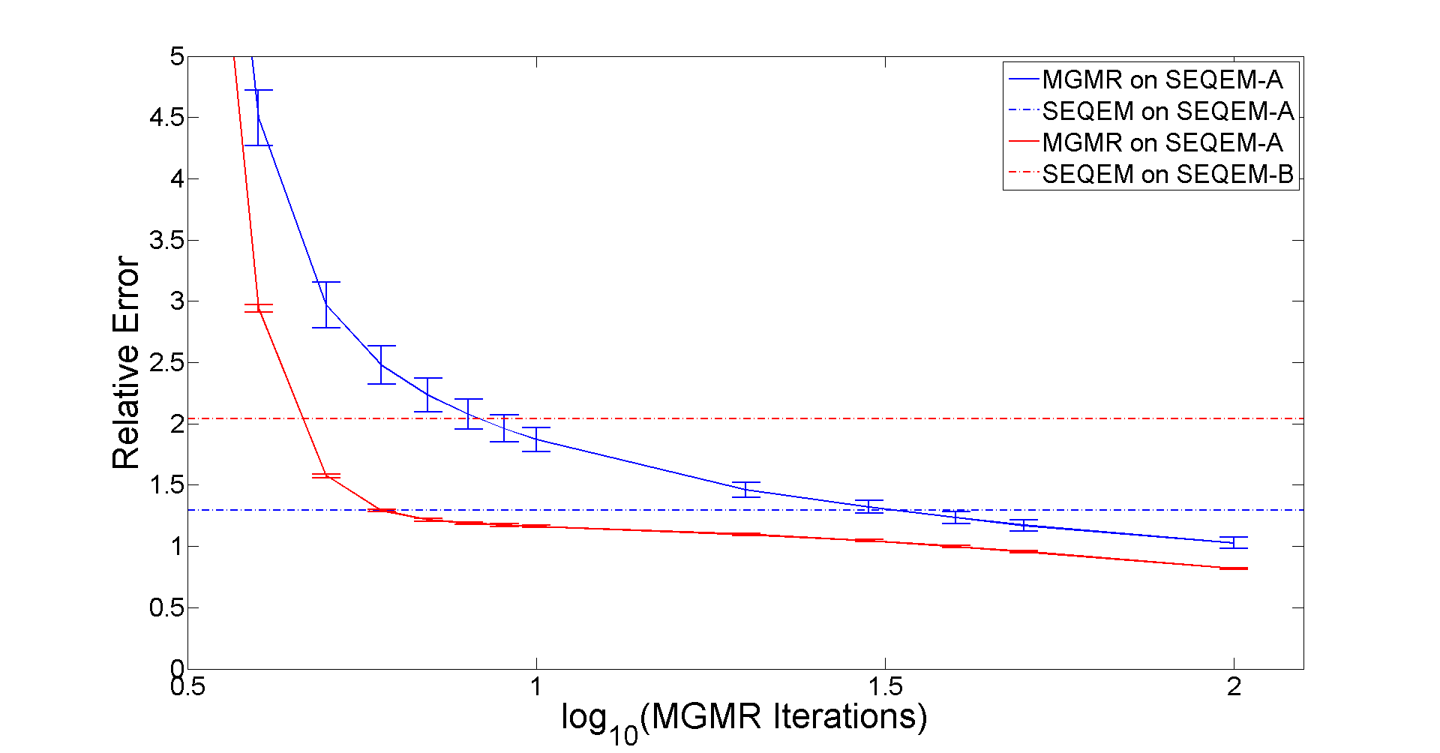

Slide 12
Backtracking: hacks, heuristics used
Alphas initialized to one
-1 ignored in P update
Zeros replaced by small values
Use one iteration of each update to keep close
Notes:
Show gif movie in browser
-log dirichlet distribution with all alphas equal, multiplied by varying constant
-greater constants lead to more concentration at center
-mean of alphas is each value divided by their sum

Slide 13
SEQEM range | Min. Error | Max Error | Mean Error | Median error | # of elements
[0,1e-6) | 47 | 5.2e+5 | 1.4e+5 | 3.0e+4 | 224
[1e-6,1e-5) | 5.6e-2 | 1.7e+5 | 1.3e+4 | 8.0e+2 | 94
[1e-5,1e-4) | 5.2e-2 | 7.9e+4 | 2.7e+3 | 31 | 83
[1e-4,1e-3) | 4.4e-3 | 6.9e+2 | 34 | 0.94 | 68
[1e-3,1e-2) | 0.25 | 63 | 2.9 | 0.92 | 44
[1e-2,1e-1) | 0.49 | 4.9 | 1.4 | 0.96 | 13
[1e-1,1] | 0.97 | 0.99 | 0.98 | 0.98 | 3
After 1 iteration, S = 5.4e+4
SEQEM range | Min. Error | Max Error | Mean Error | Median error | # of elements
[0,1e-6) | 0.33 | 5.2e+8 | 7.8e+6 | 1.8e+2 | 224
[1e-6,1e-5) | 2.1e-2 | 3.7e+8 | 7.4e+6 | 7.4e+3 | 94
[1e-5,1e-4) | 8.9e-2 | 3.1e+8 | 5.8e+6 | 8.7e+3 | 83
[1e-4,1e-3) | 0.71 | 1.7e+6 | 6.8e+4 | 9.6e+2 | 68
[1e-3,1e-2) | 6.0e-2 | 4.1e+5 | 1.2e+4 | 2.3e+2 | 44
[1e-2,1e-1) | 0.21 | 8.5e+3 | 1.7e+3 | 81 | 13
[1e-1,1] | 0.43 | 1.1e+2 | 37 | 5.8 | 3
After 100 iterations, S=1.1e+7
Notes:
Used Dirichlet package to estimate alphas & initialize MGMR (along with SEQEM P estimates), did not remove ones on P updates
-instead treated as if equal to one when
Measured with relative error
Also tried all constant greater than one, compared with earlier method →

Slide 14
Interests
Where does method fail, where does it succeed?
Heuristics have been applied – are they justified, necessary?

Slide 15
Next Tests
More controls for better understanding
Examine results on another population
Test each method on both gene and transcript level
Take advantage of population level structure – compare expression of known genes, cross validate
Understand behavior of alpha parameters and their impact

